Slide 1
JAVA
Java Introduction + Object-Oriented Programming
Eduardo Zenebre
Software Developer
10/2019

Slide 2
Agenda
About Java
Java Basics
OOP Introduction

Slide 3
About Java

Slide 4
Java Introduction
History
Virtual Machine
JRE/JDK
Bytecode
Hello World

Slide 5
Hello World
public class HelloWorld {
public static void main(String[] args) {
System.out.println("Hello, World!!!");
}
}

Slide 6
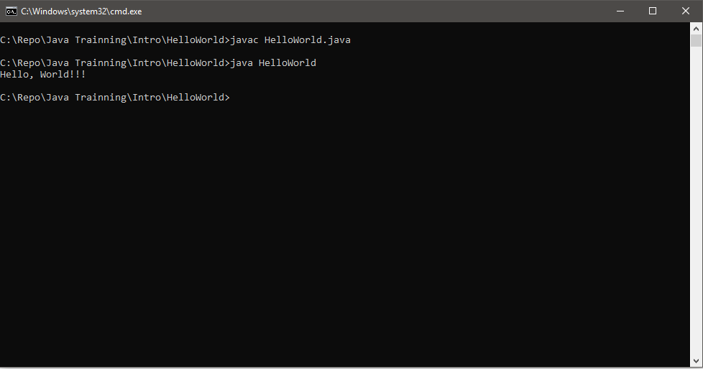
Hello World

Slide 7
2
Java Basics

Slide 8
Java Basics
Variables
Casting
IF/ELSE
While
For

Slide 9
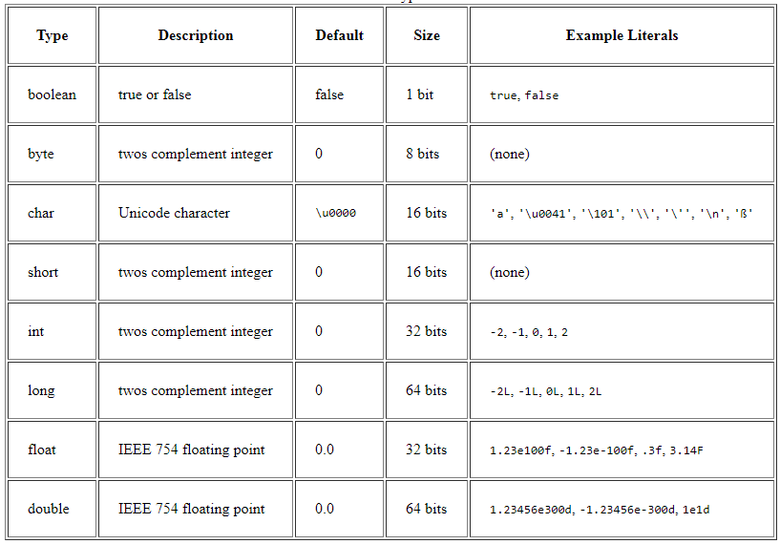
Variables

Slide 10
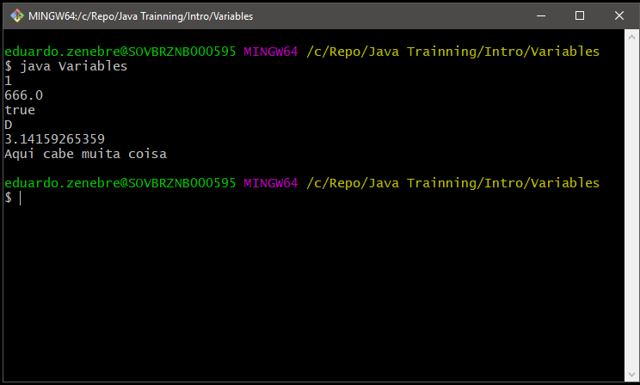
Variables
public class Variables{
public static void main(String[] args){
// Declarations
int a = 1;
float b = 666;
boolean c = true;
char d = 'D';
double e = 3.14159265359;
String f = "Aqui cabe muita coisa";
// Output
System.out.println(a);
System.out.println(b);
System.out.println(c);
System.out.println(d);
System.out.println(e);
System.out.println(f);
}
}

Slide 11
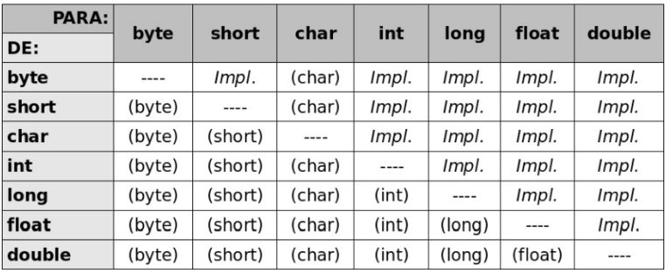
Casting

Slide 12
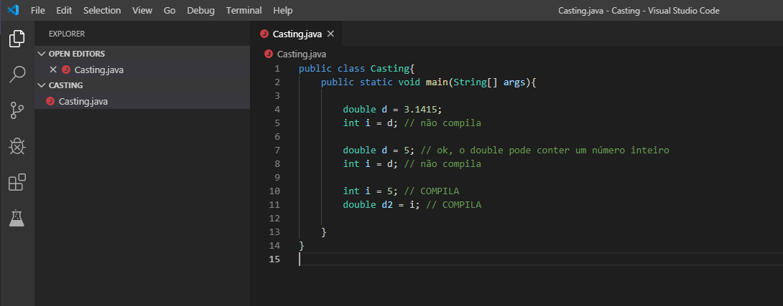
Casting

Slide 13
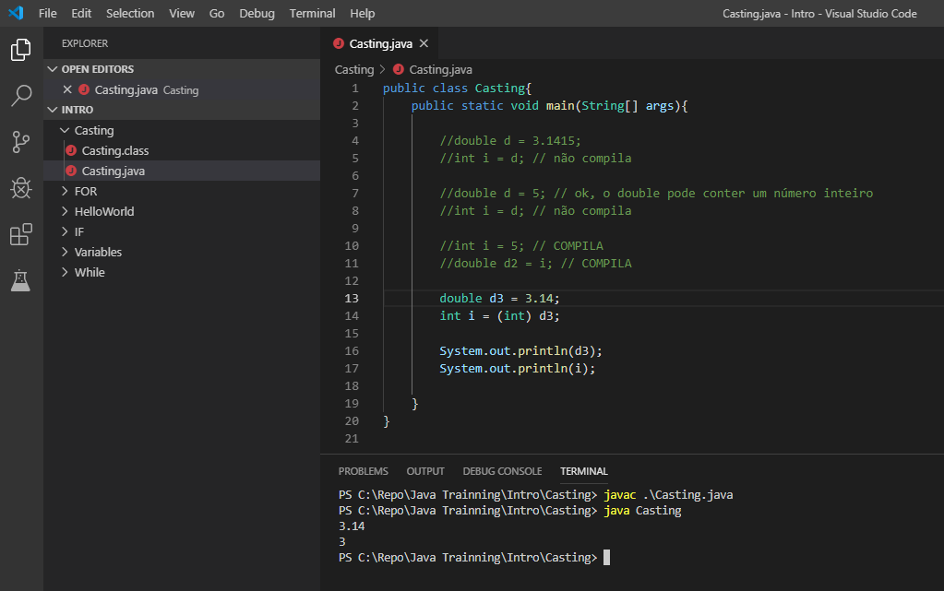
Casting

Slide 14
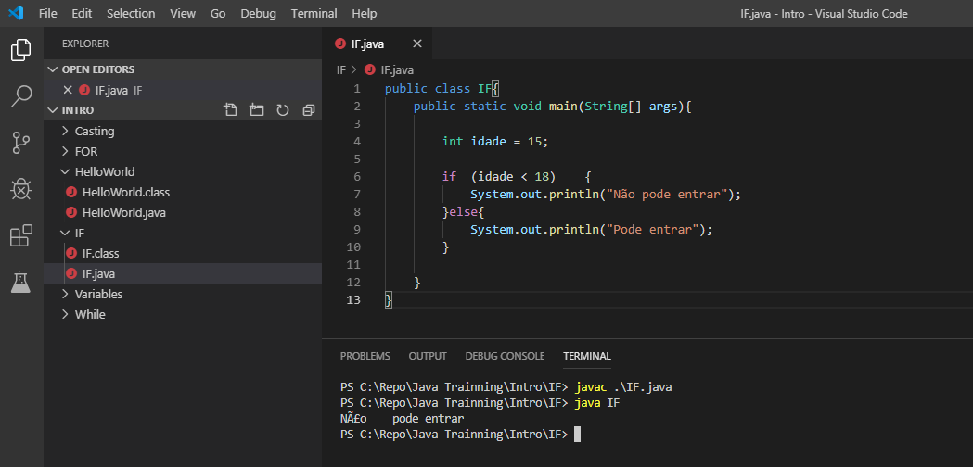
IF/ELSE

Slide 15
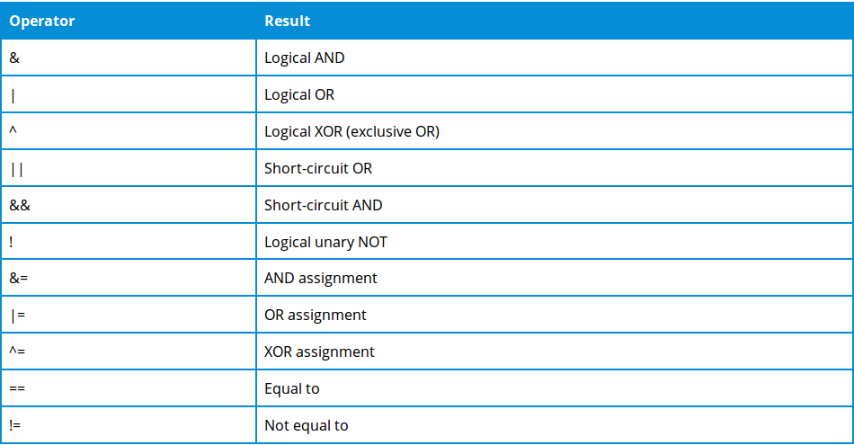
IF/ELSE - Logical Operators

Slide 16
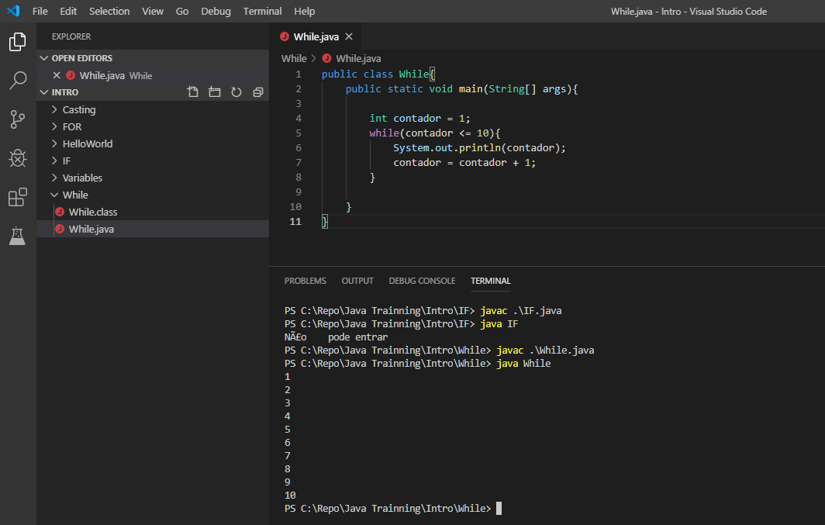
WHILE

Slide 17
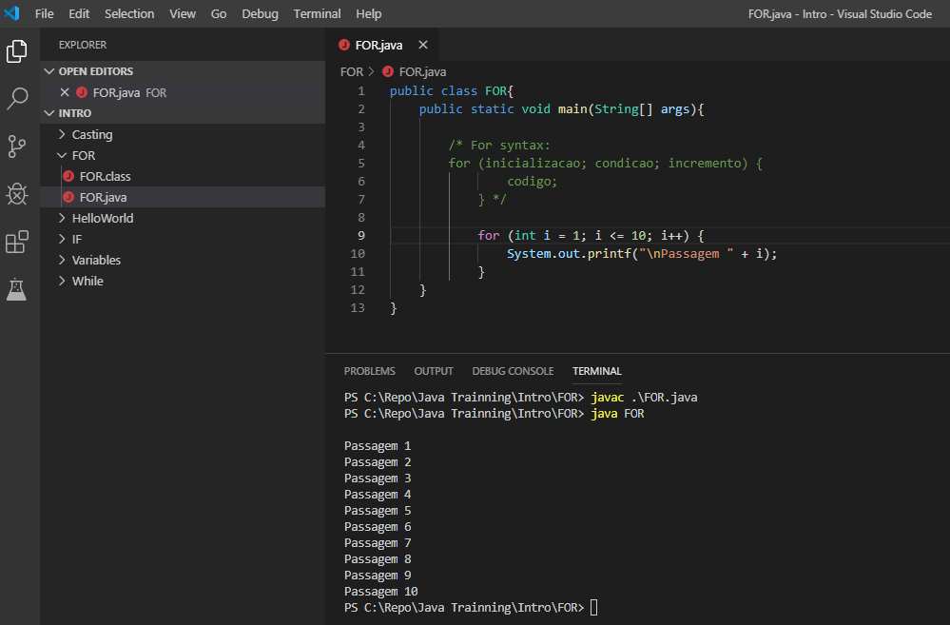
FOR

Slide 18
3
Object-Oriented Programming

Slide 19
Object-Oriented Programming
Pillars of OOP:
State and Behavior
Inherintance
Abstraction
Polymorphism
Encapsulation
Interface

Slide 20
State and Behavior
Class and Object
Attributes
Methods
Constructor
Instance

Slide 21
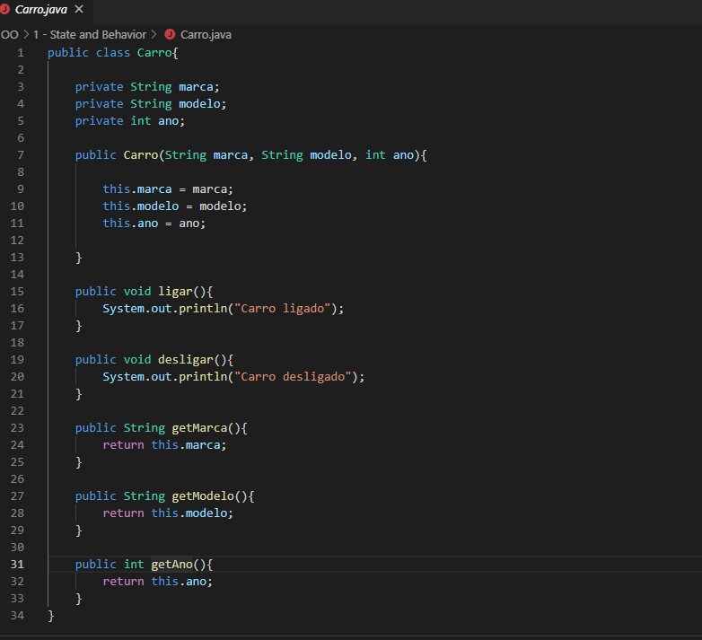
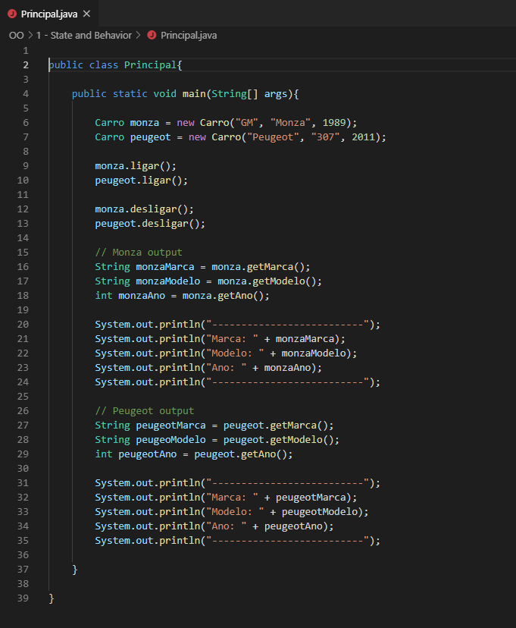
Class and Object - Exemple

Slide 22
Inheritance
Super Class
Subclass 1
Subclass 2
Subclass 3
Subclass 4

Slide 23
Abstraction
Abstract Class
Abstract Method

Slide 24
Polymorphism
Change behavior without changing the object.

Slide 25
Encapsulation
Access Modifiers
Public
Protected
Private
Default

Slide 26
Interface
Design by contract

Slide 27
Source Code
All source codes are in:
https://github.com/ezenebre/Java-Trainning

